Slide 1
Chapter 9
Protecting Innovation

Slide 2
TEACHING OBJECTIVES
1. Develop an understanding of the mechanisms a firm has available to protect an innovative technology, the means by which the mechanisms can be put into effect and their limitations.
2. Provide a basis for evaluating the type of protection mechanism to use and the extent to which the protections should be applied. To determine where on the continuum between wholly proprietary and wholly open the firm should place its technology.

Slide 3
Overview
Firms must decide whether and how to protect their technological innovations.
Protecting innovation helps a firm retain control over it and appropriate the rents from it.
However, sometimes not protecting a technology is to the firm’s advantage – it may encourage others to support the technology and increase its likelihood of becoming dominant.
Notes:
3

Slide 4

Appropriability
Appropriability: The degree to which a firm is able to capture the rents from its innovation.
  Appropriability is determined by how easily or quickly competitors can copy the innovation.
    Some innovations are inherently difficult to copy (tacit, socially complex, etc.)
    Firms may also attempt to protect innovations through patents, trademarks, copyrights or trade secrets.
Notes:
4

Slide 5
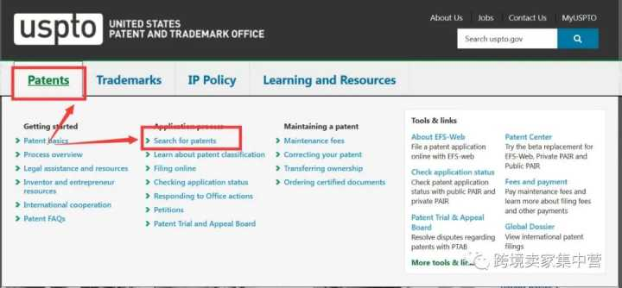
Patents, Trademarks and Copyrights
Patents, trademarks and copyrights each protect different things.
  Patents: rights granted by the government that excludes others from producing, using, or selling an invention.
  Must be useful, novel, and not be obvious.
    Utility patents protect new and useful processes, machines, manufactured items or combination of materials.
    Design patents protect original and ornamental designs for manufactured items.
    Plant patents protect distinct new varieties of plants.
  In 1998, many software algorithms became eligible for patent protection.
Notes:
5

Slide 6
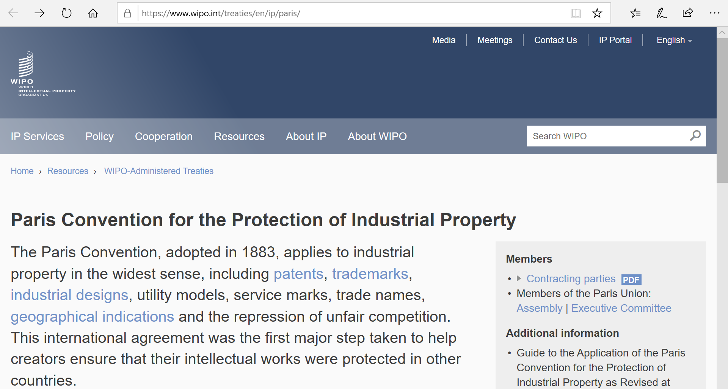
Patent Laws Around the World
  Countries have their own laws regarding patent protection. Some treaties seek to harmonize these laws.
    Paris Convention for the Protection of Industrial Property
      Foreign nationals can apply for the same patent rights in each member country as that country’s own citizens.
      Provides right of “priority” – once inventor has applied for protection in one member country, they can (within certain time period) apply for protection in others and be treated as if they had applied on same date as first application.
    Patent Cooperation Treaty (PCT)
      Inventor can apply for patent in a single PCT receiving office and reserve right to apply in more than 100 countries for up to 2 ½ years. Establishes date of application in all member countries simultaneously. Also makes results of patent process more uniform.
Notes:
6

Slide 7
Patents, Trademarks and Copyrights Continued
PCT Covered countries
Non-PCT Covered countries
    Countries that are members of Patent Cooperation Treaty
Notes:
7

Slide 8
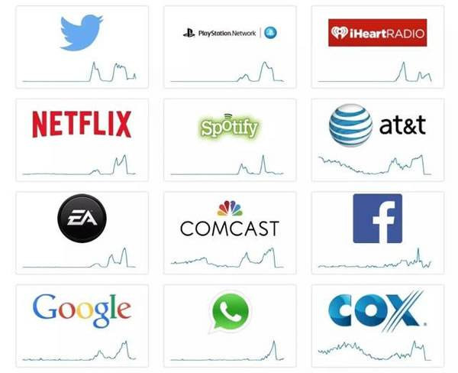
Patents, Trademarks and Copyrights Continued
  Trademarks and Service Marks: a word, phrase, symbol, design, or other indicator that is used to distinguish the source of goods form one party from goods of another (e.g., Nike “swoosh” symbol)
    Rights to trademark are established in legitimate use of mark; do not require registration.
    However, marks must be registered before suit can be brought over use of the mark.
    Registration can also be used to establish international rights over trademark.
  Two treaties simplify registration of trademarks in multiple countries: Madrid Agreement Concerning the International Registration of Marks, and the Madrid Protocol. Countries that adhere to either or both are in Madrid Union (84 members)
Notes:
8

Slide 9
Patents, Trademarks and Copyrights Continued
  Copyright: a form of protection granted to works of authorship.
    Copyright prohibits others from:
      Reproducing the work in copies or phonorecords
      Preparing derivative works based on the work
      Distributing copies or phonorecords for sale, rental, or lease
      Performing the work publicly
      Displaying the work publicly
    Work that is not fixed in tangible form is not eligible.
    Copyright is established in first legitimate use.
    However, “doctrine of fair use” stipulates that others can typically use copyrighted material for purposes such as criticism, new reporting, teaching research, etc.
    Copyright for works created after 1978 have protection for author’s life plus 70 years.
Notes:
9

Slide 10
Copyright Protection Around the World
  Copyright law varies from country to country.
  However, the Berne Union for the Protection of Literary and Artistic Property (“Berne Convention”) specifies a minimum level of protection for member countries.
  Berne convention also eliminates differential rights to citizens versus foreign nationals.
Notes:
10

Slide 11
Trade Secret: information that belongs to a business that is generally unknown to others.
  Firm can protect proprietary product or process as trade secret without disclosing detailed information that would be required in patent.
  Enables broad class of assets and activities to be protectable.
  To qualify:
    Information must not be generally known or ascertainable.
    Information must offer a distinctive advantage to the firm that is contingent upon its secrecy.
    Trade secret holder must exercise reasonable measures to protect its secrecy.
Notes:
11

Slide 12

The Effectiveness and Use of
Protection Mechanisms
In some industries, legal protection mechanisms are more effective than others
  E.g., in pharmaceutical patents are powerful; in electronics they might be easily invented around.
In some situations, diffusing a technology may be more valuable than protecting it.
However, once control is relinquished it is difficult to reclaim.
Notes:
12

Slide 13
Theory In Action
IBM and the Attack of the Clones
In 1980, IBM was in a hurry to introduce a personal computer (PC). It used off-the-shelf components such as Intel microprocessors an operating system from Microsoft, MS DOS.
It believed that its proprietary basic input/output system (BIOS) would protect the computer from being copied.
However, Compaq reverse engineered the BIOS in a matter of months without violating the copyright, and quickly introduced a computer that behaved like an IBM computer in every way. Compaq sold a record-breaking 47,000 IBM-compatible computers its first year, and other clones were quick to follow.
Notes:
13

Slide 14
Wholly Proprietary Systems vs. Wholly Open Systems
  Wholly proprietary systems are based on company-owned technology protected by patents or some other means.
  The technology is generally not compatible with other manufacturers’ products and the developer is usually able to appropriate rents from the technology.
  Customers may resist adopting these technologies because of their higher costs and lack of compatibility with other products.
  Wholly open systems may be freely accessed, augmented and distributed by anyone. Such technologies are usually quickly commoditized and provide little appropriability of rents to their developers.
  Many technologies lie somewhere between these extremes.
Notes:
14

Slide 15
Wholly Proprietary Systems vs. Wholly Open Systems
  Wholly proprietary systems are based on company-owned technology protected by patents or some other means. The technology is generally not compatible with other manufacturers’ products and the developer is usually able to appropriate rents from the technology. Customers may resist adopting these technologies because of their higher costs and lack of compatibility with other products.
  Wholly open systems may be freely accessed, augmented and distributed by anyone. Such technologies are usually quickly commoditized and provide little appropriability of rents to their developers.
  Many technologies lie somewhere between these extremes.
Notes:
15

Slide 16
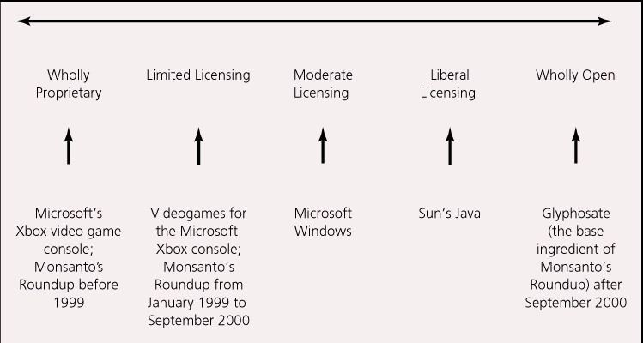
FIGURE 9.1 Examples on the Continuum from Wholly Proprietary to Wholly Open
Notes:
16

Slide 17
  Advantages of Protection
    Proprietary systems offer greater rent appropriability.
    Retain architectural control (i.e. meaning the ability to determine the structure and operation of the technology and its compatibility with other goods and services).
  Advantages of Diffusion
    Diffusion encourages rapid adoption, resulting in a large installed base and a strong market for complementary goods.
    Open technologies may also benefit from the additional development efforts of other parties without additional cost to the original developer.
Notes:
17

Slide 18
  Factors influencing benefits of protection vs. diffusion
      Can firm produce the technology at sufficient volume or quality levels?
      Are complements important? Are they available in sufficient range and quality? Can the firm afford to develop and produce them itself?
      Is there industry opposition against sole source technology?
      Can the firm improve the technology well enough and fast enough to compete with others?
      How important is it to prevent the technology from being altered in ways that fragment it as a standard?
      How valuable is architectural control to the firm? Does it have a major stake in complements for the technology?
Notes:
18

Slide 19
The Digital Music Distribution Revolution
In 1991, Fraunhofer IIS of Germany invents the MP3 format; by late 1990’s the format is wildly popular.
In 1999, Shawn Fanning releases Napster, a free software program that allows users to easily share MP3 files (“peer-to-peer”)
The RIAA starts to worry about illegal trade of copyrighted music. In 2001 it gets a court ruling against Napster, taking it offline.
However, new peer-to-peer music services began to sprout up to meet the demand of the large population of “music pirates.”
In 2003, Apple opens its iTunes Music Store – a one-stop-shop for music files from the five major record labels. Now record industry is earning significant revenues from MP3s.
In 2006, France pushes Apple to loosen its restrictions on iTunes music and iPods. Should Apple use a more “open” model?
Meanwhile, new models of digital distribution were emerging: Creative Commons (license agreements to make files public, legal, and free), and “Podcasting” (whereby whole “shows” could be downloaded).
Notes:
19

Slide 20
The Digital Music Distribution Revolution Continued
Discussion Questions:
1. What industry conditions lead to the revolution in audio distribution? Which stakeholders stand to benefit most (or least) from this revolution?
2. Why did the music stores created by the record labels fail to attract many subscribers? What, if anything, should the record labels have done differently?
3. What will determine how long the success of the iPod and iTunes endures? Should Apple allow its iPods to play non-iTunes songs? Should Apple allow iTunes songs to play on non-iPod MP3 players?
4. Why would musicians sign away their copyright privileges to their songs through “Creative Commons”?
5. How is podcasting likely to impact the appropriability of recorded music, radio broadcasting, or other types of audio transmissions?
Notes:
20

Slide 21
Discussion Questions
What are the differences between patents, copyrights, and trademarks?
Consider a firm that is considering marketing its innovation in multiple countries. What factors should this firm consider in formulating its protection strategy?
When will trade secrets be more useful than patents, copyrights or trademarks?
Can you identify a situation in which none of the legal protection mechanisms discussed (patents, copyrights, trademarks, trade secrets) will prove useful?
Describe a technological innovation not discussed in the chapter, and identify where you think it lies on the control continuum between wholly proprietary and wholly open.
What factors do you believe influenced the choice of protection strategy used for the innovation identified above? Do you think the strategy was a good choice?
Notes:
21

